Slide 1
Year 11

Slide 2
Message from Mrs McCaffrey
Hello Year 11,
I hope that you find this presentation helpful. The aim is to give you some ideas about how you can organise your time and focus on all the things that are important at this time.
You are at a very exciting point in your lives where you have decisions to make that will impact your future. Take the time to read through each slide and digest the information provided.
If you look at this time as preparation for the future you can reflect on the following:
Can you learn a new skill to enhance your personal statement?
What have you done recently that has helped you to grow as a person?
What can you do in the next few weeks that will help you with future employment?
Can you think of ways to develop your personal qualities and attributes?
Hopefully you will keep re-visiting this presentation as a reference to help guide you. Good luck!

Slide 3
Contents Page
Slide Number/s | Topic
Slides 4 – 5 | College Information
Slides 6 – 7 | Your Future
Slides 8 – 11 | Wellbeing & Looking after yourself
Slide 12 - 13 | Reading
Slides 14 | Leadership
Slide 15 | Serve God, serve others
Slide 16 | Random Acts of Kindness
Slide 17 | Enrichment

Slide 4
Y11 College Information
Colleges have all been working hard to get information for all subjects on their websites. Click on the links below, select the course/s you are doing and there will be some research, reading or a website link that will help you get a head start on your college course.
Runshaw | Runshaw will be providing Year 11 pupils with suggested bridging work later in the year. This will be available on the college website. Keep checking their website and look out for links being shared within the Year 11 St Michael’s Team.
Newman | Newman have produced a website called ‘Newman Beginnings’ They would like pupils to go to this website to bridge the gap to their A-Level and BTEC studies https://cardinalnewmancollege.cmail20.com/t/ViewEmail/j/7CCA97CAD32F0D812540EF23F30FEDED. Scroll down and select either A-Level, BTEC or T-Level.
Wigan & Leigh | Bridging materials for learners continue to be available online https://www.wigan-leigh.ac.uk/about/coronavirus-update/applicants.
Preston College | Year 11 learners who have applied to Preston College will receive an introduction from their Head of School for their area, videos, research exercises and links to the various career paths available to them through their chosen programme. If you do not receive an email some time after applying please contact guidance@preston.ac.uk who will resend the link.

Slide 5
Y11 College Information
The links below direct you to information relating to maths, English and science. Each will give you some advice on how you can prepare for the next phase in your education by giving you useful books to read, links to different activities and insight into key knowledge that will prepare you for your next steps.
English | Maths | Science
https://tetw.org/Greats https://www.gutenberg.org/ https://www.ucl.ac.uk/internet-grammar/ | https://www.runshaw.ac.uk/mathematics-a-level/ | https://www.bbc.co.uk/bitesize/examspecs/zpgcbk7 http://chemguide.co.uk/ https://www.cyberphysics.co.uk/
For more information and website guidance, click on the college websites on the previous page for information specific to the college course you are planning to take.

Slide 6
Your Future
As Mrs Jenks reminds you, at St Michael’s you have not just grown academically…
Education is about so much more than qualifications and exam results, as important as they are, education is about the growth that you make as an individual. As a school we invest so much time in helping you to grow as young people, because we believe that it is your character that will provide the support system for life. That can’t be measured in exam results alone, it’s about all of your achievements, the way you excel not just academically but also in sport, the arts, the care and compassion you have for others, they are the visible fruit of this growth. We have talked to you throughout your five years about growing in body, mind and spirit, about wanting you to flourish and have the joy and hope of life in all its fullness. It has been an absolute pleasure to see you grow and develop into the bright shining stars that you are.
Remember, you are AMAZING!

Slide 7
Prepare for your future
Prepare for your future
Click on the websites below which will help you prepare for future interviews:
Job Centre
National Careers
Prospects
Reed
Indeed

Slide 8
Digital Healthy Schools
‘Digital Healthy Schools’ has a team dedicated to providing people with the best quality information they can regarding mobile health apps.
There are hundreds of thousands of apps out there and they are the world’s leading experts on health app reviews.
It is their mission to empower people with more responsibility for managing their health.
Digital Healthy Schools can recommend apps to support you with many aspects of your health.
You can access the Digital Healthy Schools website by typing in stmichaelscehigh.lancs.digitalhealthyschools.co.uk
If you are visiting the site on your laptop/pc you can download an app by scanning the QR code with your mobile phone camera.
Recommended Apps
Click this button & then log in to Moodle to access this list of recommended Apps.

Slide 9
Looking after yourself
Here are a few things you can do to take charge of and maintain your wellbeing:
Sleep
Sleeping well is really important for your physical and mental health, as this is when your body repairs itself and your mind is able to sort and consolidate learning. Good sleep helps you to maintain your emotional wellbeing – we can all be grumpy when we are tired! Try these tips from the Sleep Council UK: https://sleepcouncil.org.uk/advice-support/sleep-advice/7-steps-to-a-better-nights-sleep/
Eating Well
Did you know that the food you eat to fuel your body can also affect the state of your mind? Not giving our brains the right foods can reduce our ability to regulate emotions & over time a poor diet can even lead to depression. We hear a lot of conflicting advice about ‘healthy eating’, but which foods can help your mood, and what should you try to limit? Mind UK has some suggestions : https://www.mind.org.uk/information-support/tips-for-everyday-living/food-and-mood/about-food-and-mood/
Self-Awareness
Nobody can look after yourself as well as you can. The trick is to make self-care and giving yourself time to reflect on your feelings and wellbeing a daily habit. Noticing how you feel is the first step, then comes knowing what to do when you spot warning signs that you are struggling. Young Minds UK has a wealth of advice here https://youngminds.org.uk/find-help/looking-after-yourself/

Slide 10
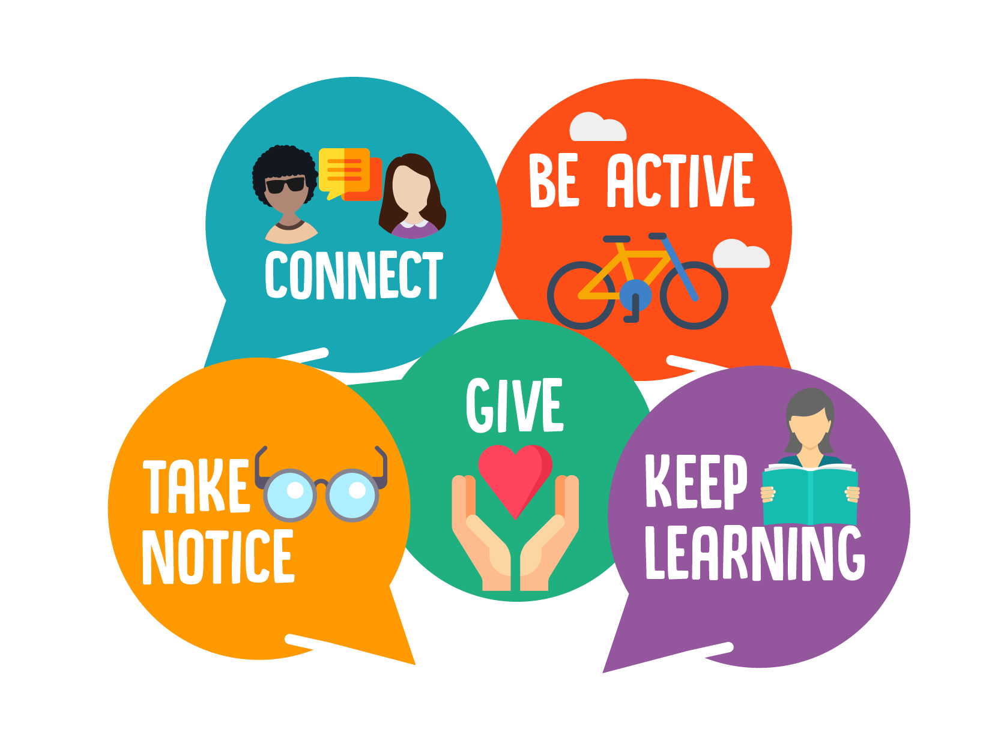
Looking after yourself
Evidence suggests that looking after your wellbeing can help to decrease mental health problems, help people to flourish and improve overall happiness. In 2008, a document produced by the New Economics Foundation (NEF) set out these 5 actions that people can take to improve their personal wellbeing. These have now been adopted worldwide by a number of health charities and governments.
You can find many examples, advice and tasks online by searching ‘the five ways to wellbeing’.
You can find NHS advice about the 5 ways to wellbeing here:
https://www.nhs.uk/conditions/stress-anxiety-depression/improve-mental-wellbeing/

Slide 11
Getting active!
Getting Active!
Obviously it is important to keep yourself fit during your revision and exam periods. Here are some suggestions for activities you can do each day…
Couch to 5k app – improve the distance and time of your running
Have a watch of Joe Wicks PE videos on Youtube
Trampolining – if you have one – learn how to somersault / different types of jumps etc
Walking – keep track of how many walks you go on and for how long
Jogging
Cycling – speed challenge
Working out online / Wii fit
Dancing –Youtube with Otimabuise, or Online Zumba activities
Yoga (Yoga with Adrian or the ‘Down Dog’ app )
Fitness challenges with your friends, eg 100 press ups, 100 sit ups etc
Sports skills – keepy uppies / shooting baskets etc

Slide 12
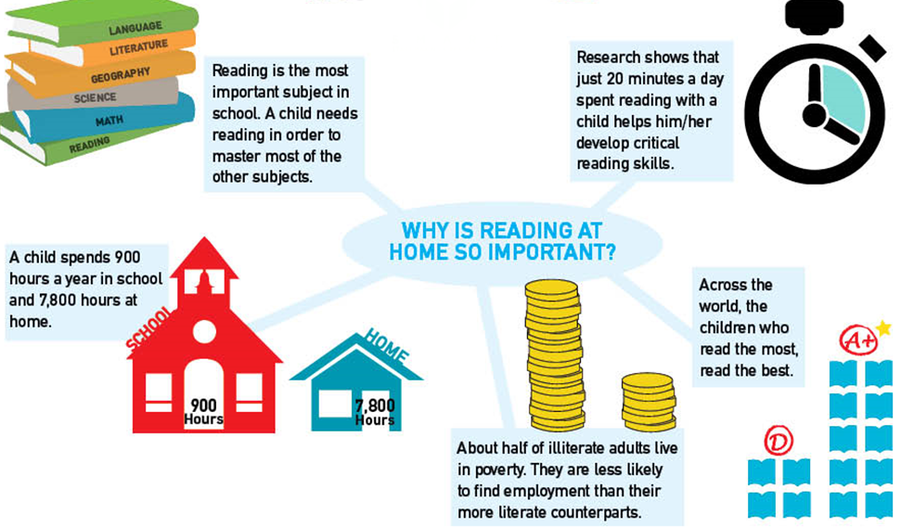
Read!
Why Reading Matters
At St Michael’s we know how important reading is and the huge positive effect it can have on your knowledge, understanding of the world and wellbeing.
Reading is not just about you being more successful academically. Reading regularly and widely (whether that be fiction, the classics, poetry, non-fiction, newspapers or blogs) will in turn improve your creativity, emotional intelligence and compassion, as well as improving your general knowledge (helpful in those zoom quizzes!) and awareness of other cultures and traditions.
Click on this button, scroll down to the bottom of the page and under the heading “Moving on after St Michael's” click the ‘Upper School Recommended Reading List’ document.

Slide 13
Read!
Reading Recommendations
Books that will thrill you
City of Bones by Cassandra Clare
The Hunger Games by Suzanne Collins
Gone by Michael Grant
Skulduggery Pleasant by Derek Landy
Savage Island by Bryony Pearce
Divergent by Veronica Roth
Books that will teach you about love
Diary of a Young Girl by Anne Frank
To all the Boys I’ve Loved Before by Jenny Han
Love at Second Sight by Cathy Hopkins
The Next Together by Lauren James
Instructions for a Secondhand Heart by Jill Murray
Books that will make you laugh
Artemis Fowl by Eoin Colfer
The Private Blog of Joe Crowley by Ben Davis
Super Awkward by Beth Garrod
Diary of a Wimpy Kid by Jeff Kinney
Geek Girl by Holly Smale
Awful Auntie by David Walliams
Books which will change the way you think
Noughts and Crosses by Malorie Blackman
Cell 7 by Kerry Drewery
The Deepest Cut by Natalie Flynn
The Bone Sparrow by Zana Fraillon
A Seven Letter Word by Kim Slater
The Book Thief by Markus Zusak
Books that will make you cry
The Boy in the Stripped Pyjamas by John Boyne
The Fault in our Stars by John Green
War Horse by Michael Morpurgo
A Monster Calls by Patrick Ness
My Sister Lives on the Mantlepiece by Annabel Pitcher
Of Mice and Men by John Steinbeck
Books that will scare you
Frozen Charlotte by Alex Bell
Fir by Sharon Gosling
Cold Bath Street by A.J. Hartley
Beyond by Graham McNamee
1984 by George Orwell
Lord Loss by Darren Shan
City of Ghosts by Victoria Schwab

Slide 14
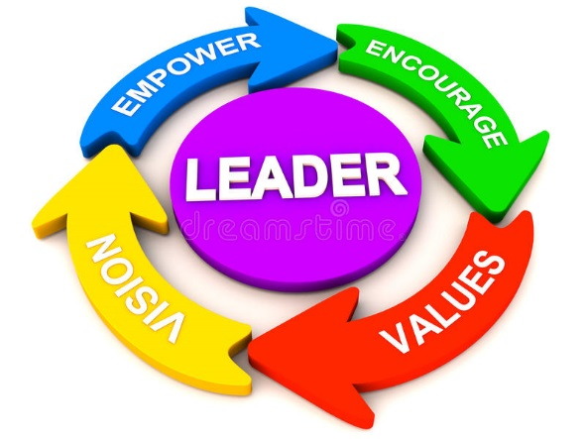
Leadership
Leadership
Colleges & employers are enthused with pupils who have leadership skills and qualities! They want pupils who are resilient, inspiring, good communicators, enjoy challenges, can make decisions, give feedback, motivators, and that can lead!!!
What have you done at St Michael’s to develop your leadership skills?
What did you do in these roles?
What have you learned from your role?
Have you enjoyed supporting/mentoring younger pupils within your role/s?
Have you developed your teamwork skills? How?
Have you motivated people? How?
Did you enjoy having the responsibility and strive for more in the future?
How have they helped you grow in body, mind and spirit?
How might the leadership skills you used or learnt help you in the future?

Slide 15
Serve God, serve others
When your exams are finishd, it is important to give yourself a period of rest and relaxation. But following this, there is likely to be a period where you find you have time on your hands.
Remember, part of our St Michael’s vision is to ‘serve God,’ and we can easily fulfil this mission by being sensitive to others’ needs and performing ‘random acts of kindness.’
We hope you have managed to do some of the suggestions on the next slide already, but if not, why not spend some time thinking not of how you are feeling today, but what you can do for others.
And remember, research says that performing a small act of kindness actually makes you happier too!

Slide 16
Random acts of kindness
… the garden? Weeding, mowing the lawn?
… help a sibling with their schoolwork?
… go on a walk, take a bag and pick litter on the way?
… follow a new recipe and cook tea for your family tonight?
… ring an elderly friend and offer to do their shopping when you go to the supermarket?
… make a poster, design a card or send a letter to an elderly resident living in a local care home that St Michael’s has links with?
Please email any to admin@saint-michaels.lancs.sch.uk and Mrs Hooley will pass them on.
… ring your grandparents/ elderly relatives today?
… research a ‘cause’ or charity on the internet to see if there is anything you can do to help them?
…have a clearout and take some of your unwanted goods to a charity shop. Could you also ask them if you could help out there before college starts? This is a great experience to have on your CV!
Could you…
…help with the housework? Cleaning, ironing, polishing etc

Slide 17
This is from Keiths doc - I don’t think we can use it in this format because it’s copied
Enrichment
Sign Language
Have you ever thought about learning sign language? As you are under 18 for just £3 you can! Great for your cv too.
https://www.british-sign.co.uk/learn-online-british-sign-language-course/
Museums & Art Galleries
Lots of you have a passion and enjoy history, art, textiles etc. There are currently lots of virtual tours at available at a variety of locations. Click this link https://smartify.org/venues
Yoga
Yoga is an assured method of reducing your stress and anxiety. Learn Yoga with the ‘Down Dog’ app. It is free for students until July and will teach you about meditation, relaxation and breathing techniques
https://www.downdogapp.com/
Theatre Thursday!
Stuck for something to do during the week, every Thursday the ‘National Theatre’ will show free full length plays
https://www.youtube.com/channel/UCUDq1XzCY0NIOYVJvEMQjqw
Meditation
Benefits of regular meditation are; reducing stress, helps you get a good nights sleep, improves your metabolism and much more. Give it a go for free on the ‘Headspace’ app https://www.headspace.com/meditation/meditation-for-beginners
Virtual Zoos
Lots of you have expressed an interest of having a career within animal care. Click on this link and see some animals enjoying the peace and quiet at Edinburgh zoo https://www.edinburghzoo.org.uk/webcams

